Slide 1
Video Game Genre Classification
Jerry Parng

Slide 2
Overview
Project Goal
Data Exploration
Training Models
Results
Conclusion

Slide 3
Project Goal
The goal of this project is trying to solve is to classify video game genres based on attributes such as sales, gaming platform, and publisher.
This will be a classification problem where the genre will be the outcome variable. There will be 12 genres : Sports, Platform, Racing, Role-Playing, Puzzle, Shooter, Simulation, Action, Fighting, Adventure, Strategy, and Misc.

Slide 4
Data Exploration
Dataset obtained from Kaggle.com created by user Ulrik Thyge Pedersen and contains 16,598 observations and 11 variables.
There are 7 continuous variables and 4 categorical variables with 271 missing values.
Link: https://www.kaggle.com/datasets/ulrikthygepedersen/video-games-sales?resource=download

Slide 5
Data Exploration (cont.)
The name attribute is not necessary as the rank attribute can identify the games as well, so it is removed.
The 271 rows with missing values were removed as this is a small percentage of the data.
Given the large amount of levels that the publisher attribute has, it will need to be preprocessed before training and fitting models with the use of embedding.

Slide 6
Data Exploration (cont.)
Mosaic plots and chi-squared tests were used to see if there is a relationship between the categorical variables and the outcome variable (genre).
Side-by-side boxplots and ANOVA tests would be used to see if there is a relationship between the continuous variables and the outcome variable.
The plots and tests showed that there is indeed a relationship between all the variables and the outcome variable.

Slide 7
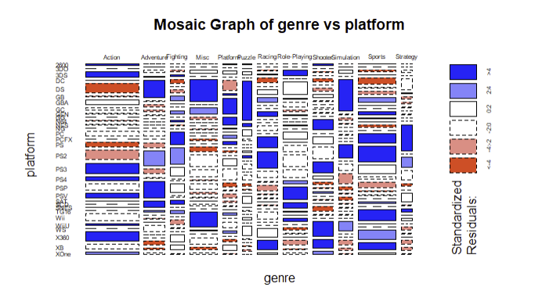

Mosaic Graph of Genre vs Platform

Slide 8
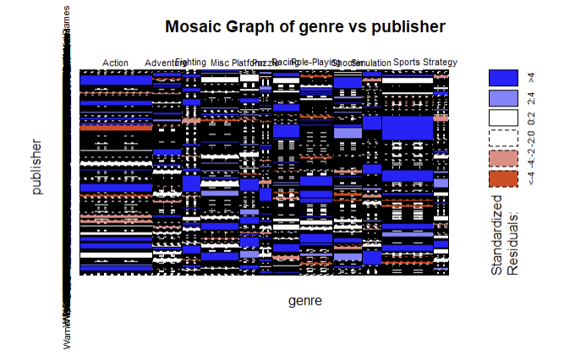

Mosaic Graph of Genre vs Publisher

Slide 9
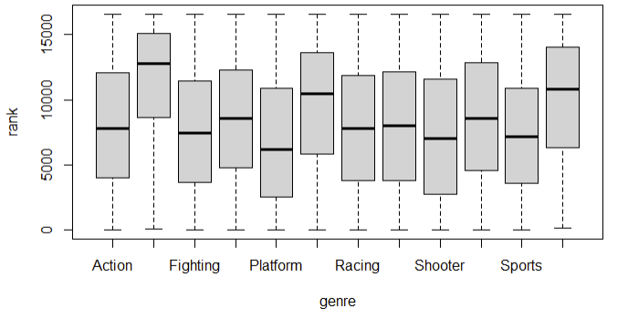

Genre vs Rank

Slide 10
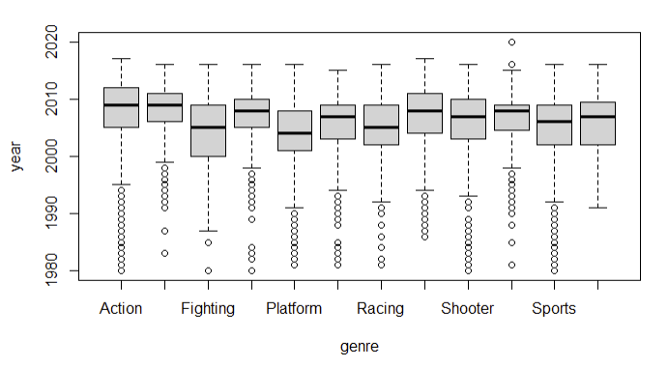

Genre vs Year

Slide 11
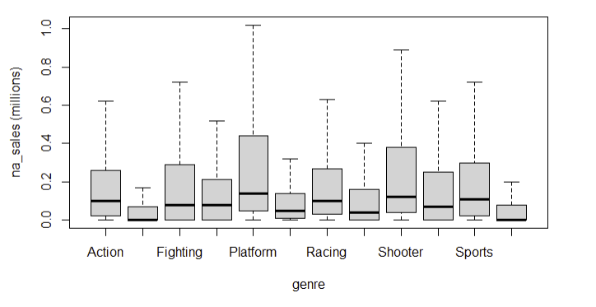

Genre vs Na_sales(millions)

Slide 12
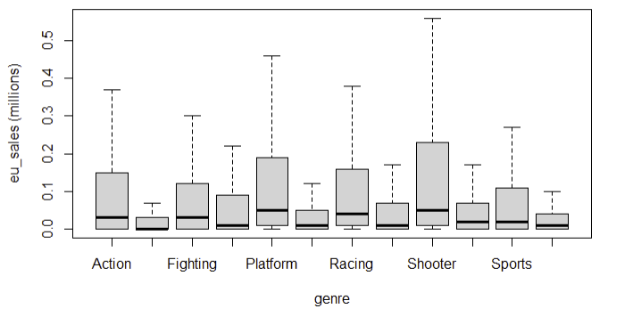

Genre vs Eu_sales(millions)

Slide 13
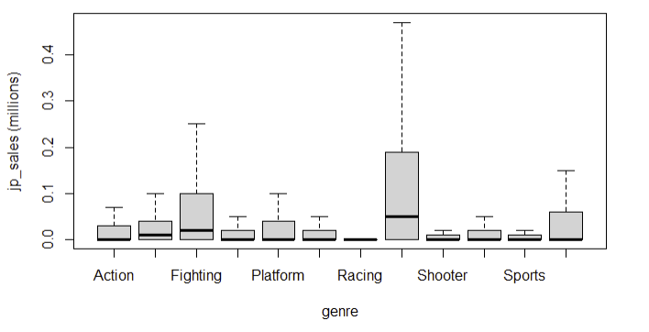

Genre vs Jp_sales(millions)

Slide 14
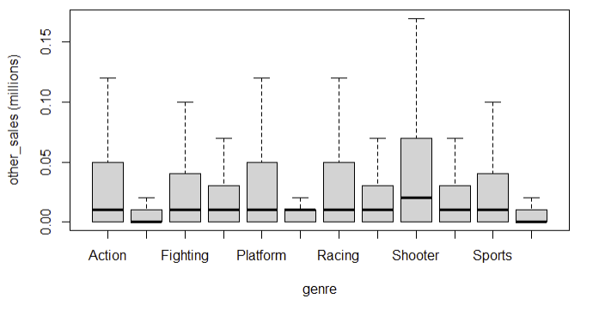

Genre vs Other_sales(millions)

Slide 15
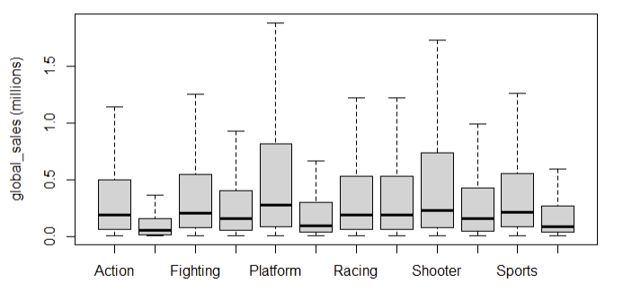

Genre vs Global_sales(millions)

Slide 16
Preprocessing
Dataset was randomized and split into testing and training data.
Testing and training data were duplicated to be used for later models.
For SVM and neural network, the dataset would have to be converted to numeric variables.
For the neural network model, categorical variables would need to be encoded with embedding vectors.

Slide 17
Model Training
10-fold cross-validation and the caret package were used to train and tune SVM Linear, SVM Radial, GBM, and random forest models.
The neural network model was created using keras. The dataset would first be split into testing and training data, and then the training data would again be split into training and validation data.
Accuracy will be taken using the “confusion matrix” function and AUC will be taken using “multiclass.roc” function.

Slide 18
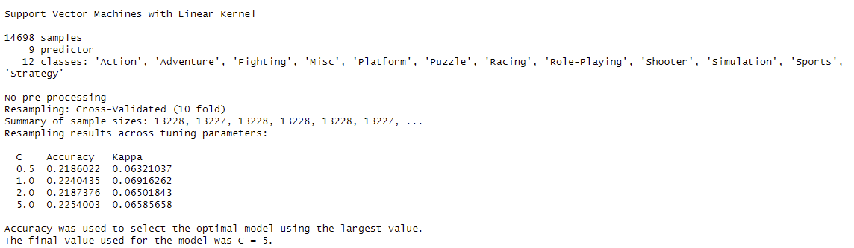
SVM Linear Model
Tune grid sizes were 0.5,1, 2, and 5
Accuracy: 23.0%
AUC: 0.521

Slide 19

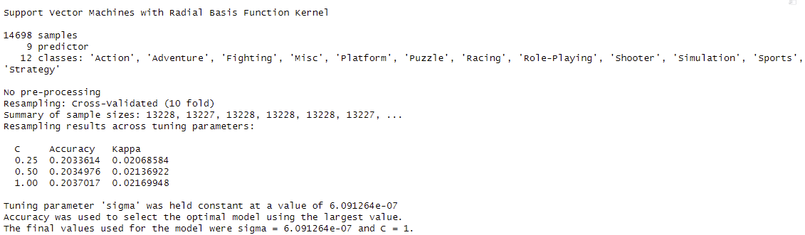
SVM Radial Model
Hyperparameters were tuned by caret
Accuracy: 19.6%
AUC: .491

Slide 20
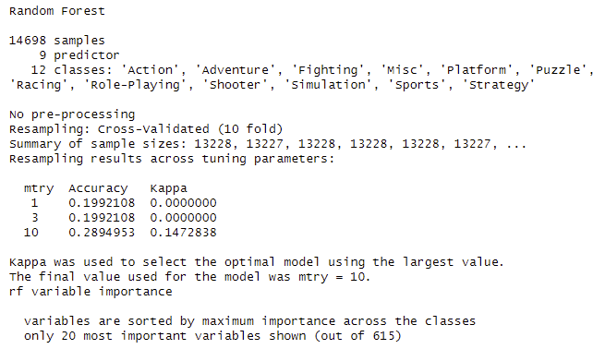
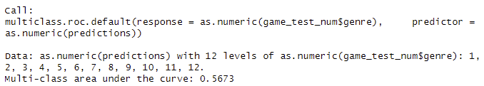
Random Forest Model
10-fold cross validation was used with tune grid values of 1,3, and 10.
Accuracy : 28.6% from Confusion Matrix
AUC: 0.567

Slide 21
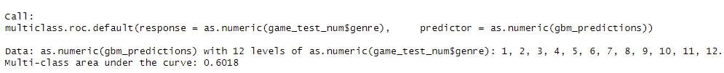
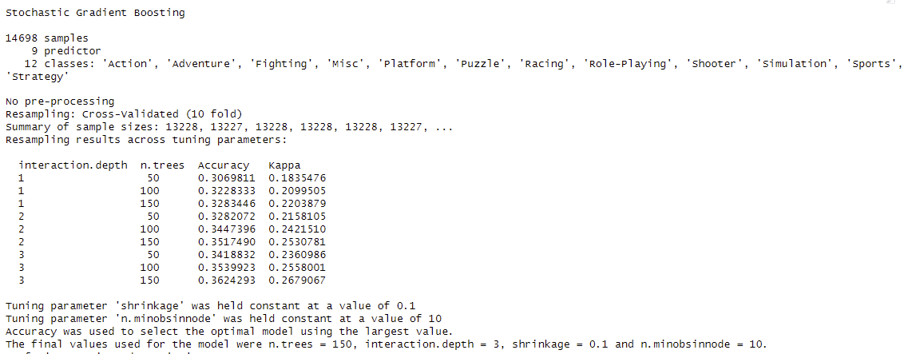
Gradient Boosted Model
The model was autotuned by caret
Accuracy: 36.5%
AUC: .602

Slide 22
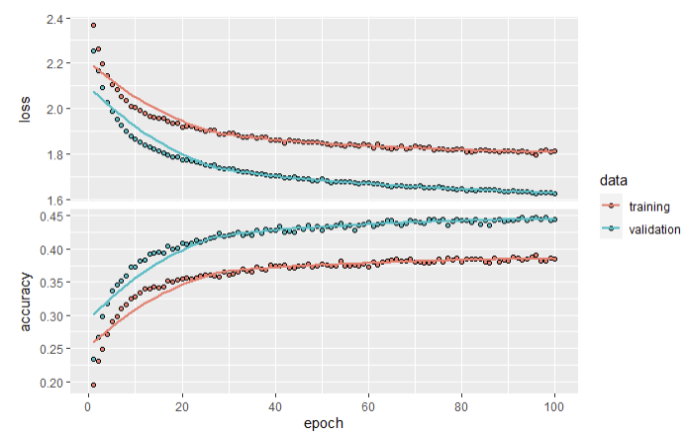

Neural Network
Tuned using “tfruns” package with flag script
Categorical variables were on-hot encoded
Accuracy: 37.8%
AUC: .624

Slide 23
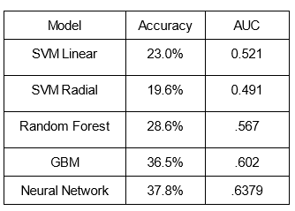
Results
Neural Network model had the highest accuracy, with GBM a close second
Accuracy overall was low (under 50%)
Fewer publisher labels would likely improve accuracy and AUC

